Slide 1
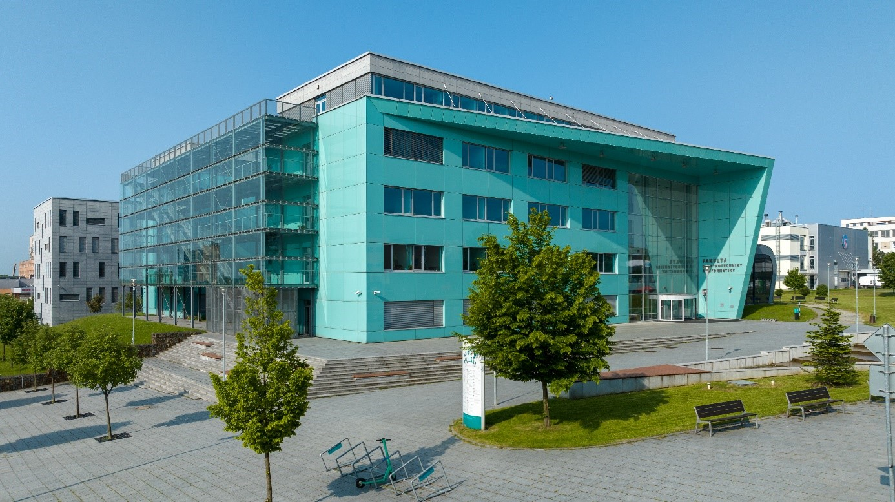








YBERC 2026
2nd – 4th September 2026, Ostrava
Organizers, Partners & Sponsors

